Slide 1
On the Expressivity of Markov Reward
By Abel et.al.
Presenter: Yibin Xiong
December 7, 2021

Slide 2
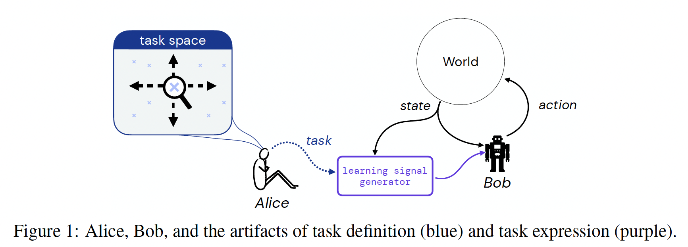
Reward Engineering as a 2-phase Problem
Reward hypothesis: “All goals and purposes can be well thought of as maximization of the expected total reward.”
Is it true? How do we figure out the appropriate reward function?
TaskQ: How do we define/specify a task? (natural language, an optimal policy, etc.)
ExpressionQ: Given the task definition, can we design a (Markov) reward function that fully expresses the task?

Slide 3

TaskQ: Definitions of Tasks
Task-as-$π^{∗}$
The most “coarse” specification of tasks; Cannot differentiate all other sub-optimal policies
SOAP (Set of Acceptable Policies)
Partitioned the policy space into 2 equivalent classes: good policies $Π_{g}$ and bad policies $Π_{b}$
PO (Partial Ordering on Policies)
Partitioned the policy space into several equivalent classes
Task-as-goal
TO (Partial Ordering on Trajectories)
Partial ordering of finite-horizon trajectories
Specifies how we want the agent to achieve the goal, i.e. process + result
Good
Good
Excellent
Bad
Good
Bad
Indifferent
Bad
Definitely Avoid

Slide 4
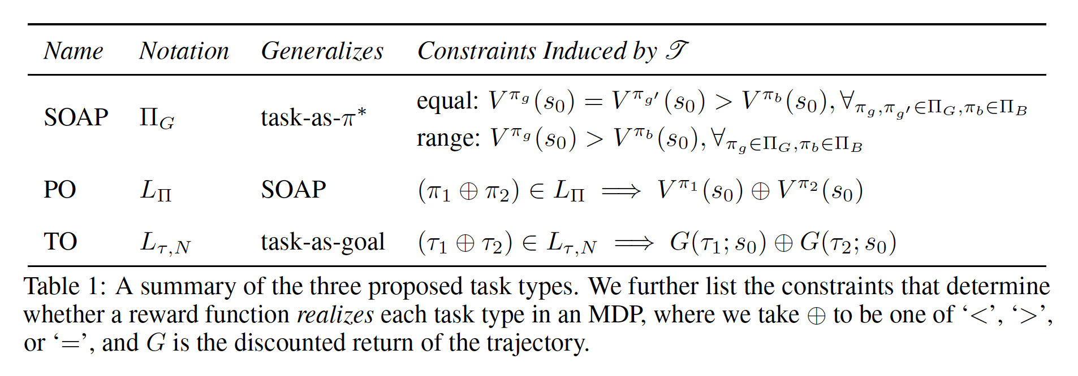

Realizability and Task Constraints
A reward function realizes the given task $𝒯$ in an environment $E=\left\{S,A,T,γ,s_{0}\right\}$ if it satisfies the constraints induced by $𝒯$.

Slide 5
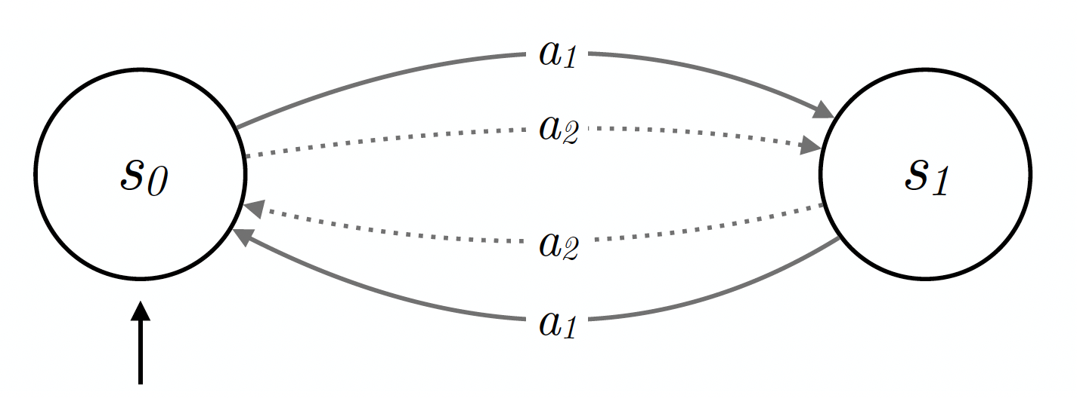


ExpressionQ: Are SOAP, PO, TO realizable?
Theorem 4.1 says No!
We can find simple counter-examples:
Proposition 4.2 generalizes this to any transition dynamics $T$ and any discount factor $γ$
SOAP/PO with $Π_{g}=\left\{π_{12}, π_{21}\right\}, Π_{b}=\{π_{11},π_{22}\}$
Notes:
Change \gamma but T is still deterministic → easy, every policy has the same V(s_0)
Change T:

Slide 6
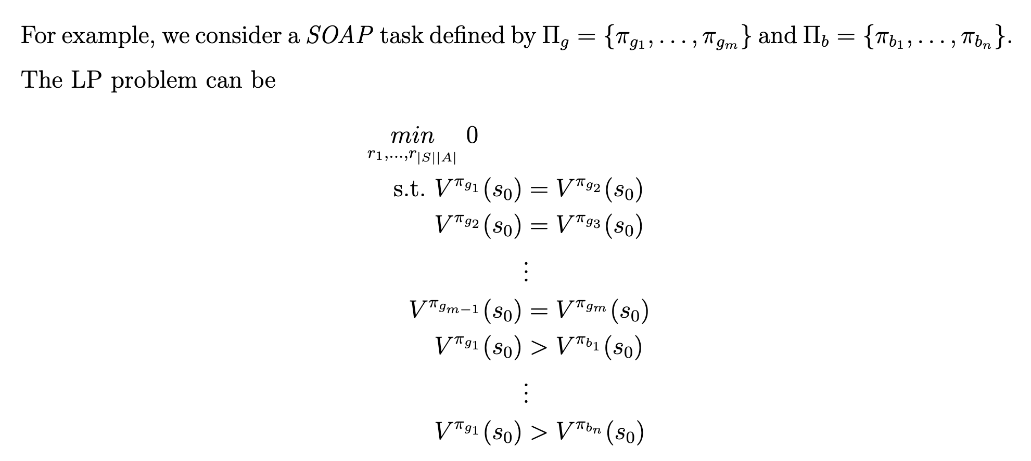
Application – An Algorithm
Determine whether a task is realizable
If so, find a reward function that realizes the task
Theorem 4.3: The REWARDDESIGN problem can be solved in polynomial time, for any finite E, and any SOAP, PO, or TO, so long as a reward-function family with infinitely many outputs is used.
This is because we can formulate the constraints into a linear programming (LP) problem

Slide 7
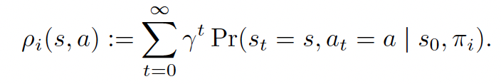
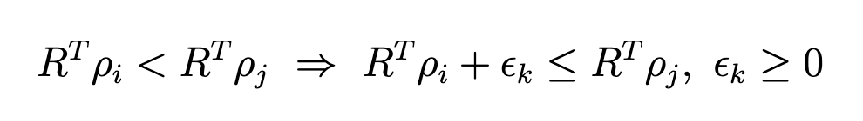


Algorithm
fringe
Trick 1: only “fringe constraints” (for SOAP)
Fringe policies deviates from the optimal policies by only 1 action
By “policy improvement theorem,” policies outside the fringe
have lower start-state values
Trick 2: estimate start-state values
Define the discounted expected state-action visitation distribution
Then $V^{π_{i}}\left(s_{0}\right)=R^{T}ρ_{i}$
If the state space and/or action space are continuous, R is a vector with infinitely many entries, i.e. a continuous function
Trick 3: add slack variables to convert $<$ to $≤$
$$π_{g}$$
policy space

Slide 8
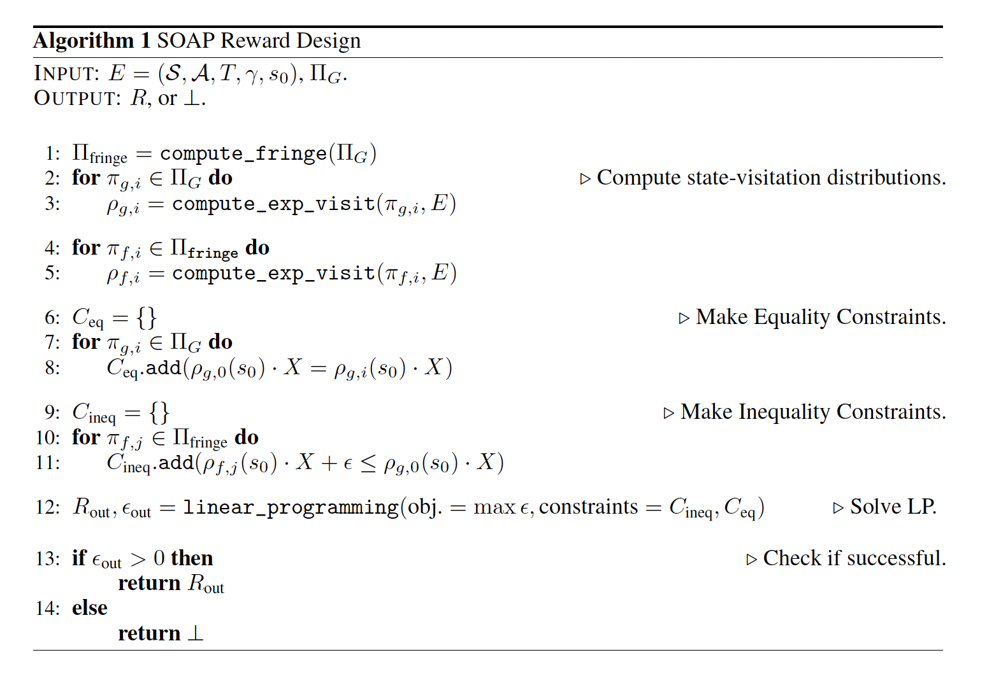

Runtime: $𝒪(N^{3})$, where $N≤{\left|A\right|}^{\left|S\right|}$or $N= max\left\{\left|S\right|,\left|A\right|\right\}$

Slide 9

More Theoretical Results
Theorem 4.5: When we require the reward function has finitely many outputs (i.e. the number of possible values that each entry can take is finite), the problem becomes NP-hard.
Proposition 4.6: For any SOAP, PO, or TO, given a finite set of CMPs, $ℰ=\{E_{1},…,E_{n}\}$ with shared state–action space, there exists a polynomial time algorithm that outputs one reward function that realizes the task (when possible) in all CMPs in $ℰ$.
In other words, transition dynamics and $γ$ do not affect the realizability much.
Theorem 4.7: Task realization is not closed under sets of CMPs with shared state-action space.
That is, there exist choices of $𝒯$ and $ℰ=\{E_{1},…,E_{n}\}$ such that $𝒯$ is realizable in each $E_{i}∈ℰ$ independently, but there is not a single reward function that realizes $𝒯$ in all $E_{i}∈ℰ$ simultaneously.

Slide 10
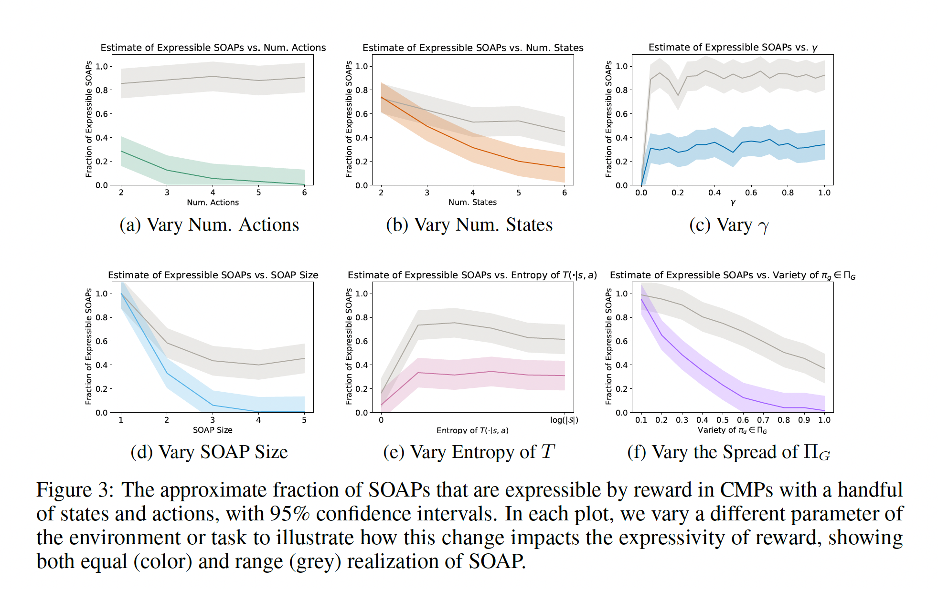

Experiments: 4 state 3 action MDP
Notes:
Verifies Thm 4.1

Slide 11
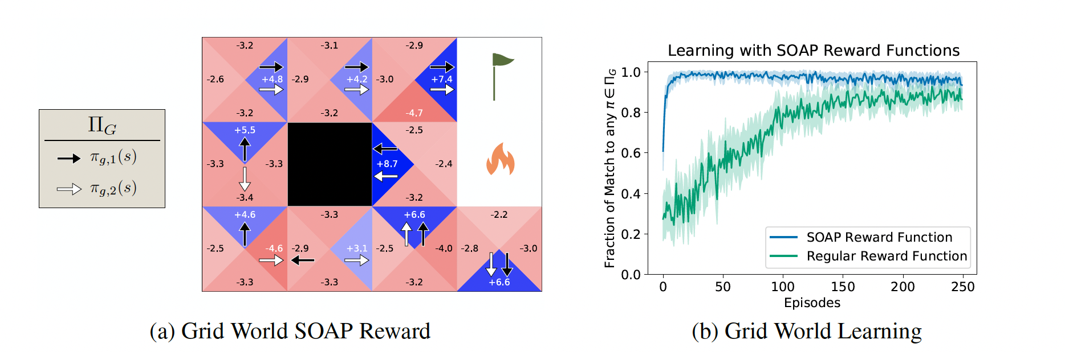

Experiments
Faster convergence
The $ε$-greedy policy when using “regular reward function” does not converge exactly to an optimal policy

Slide 12

Thoughts, Questions, Future Directions
Comparison with IRL
Maximize $ε$ is similar to the maximize the margin in traditional IRL (feature matching); non-parametric
LP problem formulation is simple and the algorithm is not iterative (we can have iterative versions that enables interaction between reward designing and policy optimization)
PO has stronger prior knowledge because of more fine-grained partition, but also more computation in fitting $ρ_{i}\left(s,a\right)$.
Feasibility:
Toy-example MDPs in the experiments; continuous state/action space $⇒$ deep neural nets
If $|Π_{g}|$ is large, we need to 1) specify all of them (SOAP equal); 2) fit $ρ(s,a)$ for each one
For PO/TO, specify a lot of orders
Assumed perfect task knowledge, but difficult to transfer task knowledge/finetune a reward function when tasks are defined by “policy/trajectory inequalities”
For TO, what if the good trajectories have different length?
Notes:
If transition dynamics are known, we compute forward and backward messages to fit $ρ\left(s,a\right)$. Otherwise, we run the policy and use empirical estimates (i.e. counts).

Slide 13
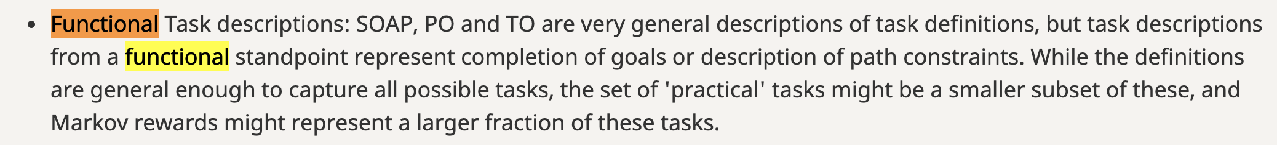
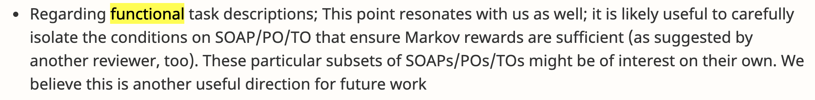
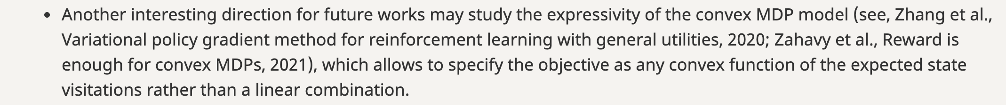
Thoughts, Questions, Future Directions
Sufficient conditions for realizability?
Other formulation of tasks
Convex rather than linear
For tasks that are not realizable, what can we do?

Slide 14
Summary
The authors
Proposed clear definitions of tasks
Examined the expressivity of Markov rewards
Explored variants of the reward design problem (finite output, shared state & action space)
Framed the problem into LP and solved it in polynomial time

Slide 15
Thank you!

